Slide 1

AI-Driven Customer Service Reminder System
Automating and personalizing vehicle service reminders for automotive dealerships and service networks using advanced data science and machine learning.

Slide 2
Project Overview: Revolutionizing Automotive After-Sales
This capstone project introduces an AI-driven system to transform how automotive dealerships manage customer service reminders. Our end-to-end data science workflow ensures efficient, personalized communication, enhancing customer loyalty and operational efficiency.
Automated Reminders
Personalized Communication
End-to-End Workflow
Predicts and sends timely service notifications.
Covers data handling, model training, and deployment.
Tailors messages and channels to individual customer needs.

Slide 3


Step 1 & 2: Data Foundation - Collection & Preprocessing
Data Collection
Data Preprocessing
Gathering all relevant customer, vehicle, and service records.
Preparing raw data for analysis and model training.
Structured Data: Tabular data (purchase year, odometer, warranty, service history, communication).
Cleaning & Transformation: Handling missing values, data type conversion, outlier filtering.
Unstructured Data: Free-text customer feedback.
Feature Engineering: Creating new features (e.g., age_of_vehicle, avg_kms_per_month).
Encoding & Sentiment Analysis: Converting categorical data, generating sentiment features from feedback.

Slide 4
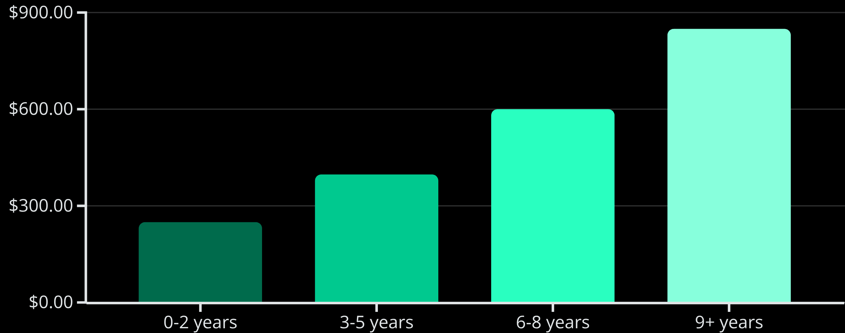
Step 3: Exploratory Data Analysis (EDA)
Gaining deep insights into the data to inform model development and identify key trends.
EDA involves understanding feature distributions (histograms, boxplots) and identifying relationships between variables (scatterplots, cross-tabulations) to determine feature importance for predictive modeling.

Slide 5
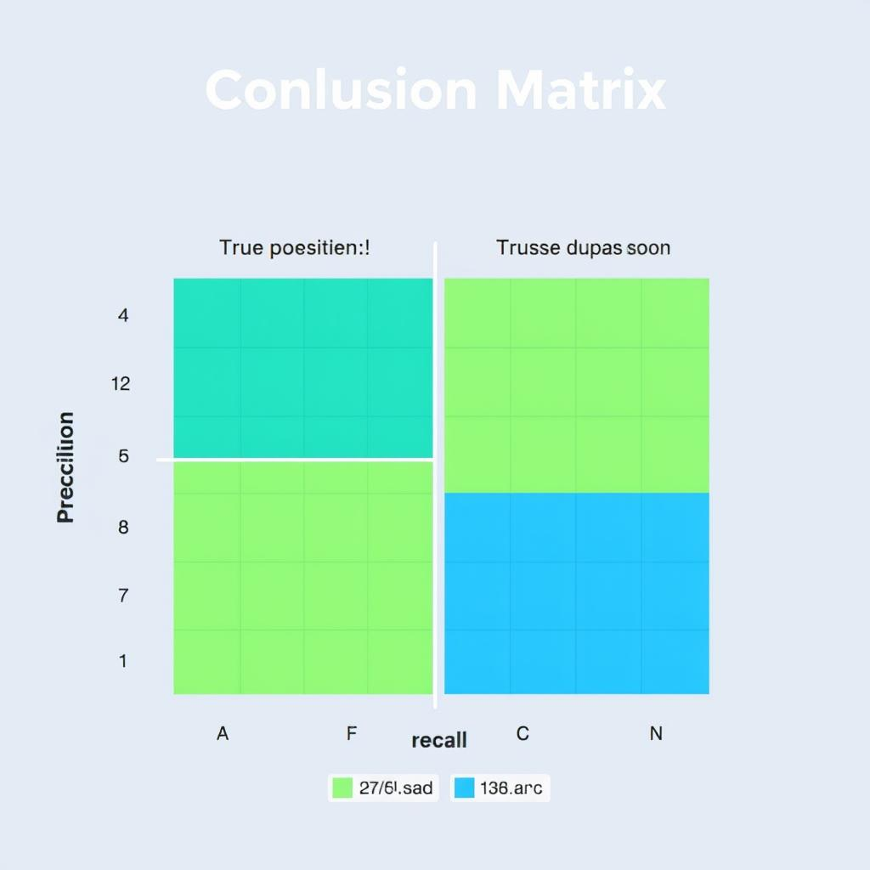



Step 4: AI Models - Classification
Predicting urgent service needs to enable proactive customer engagement.
Urgent Service Prediction
Machine Learning Techniques
Key Business Value
Identifies vehicles needing service within 120 days based on comprehensive features including odometer, last service, warranty status, and sentiment from customer feedback.
Drives proactive service reminders, reduces customer churn, enables personalized marketing, and optimizes call-center operations for high-priority customers.
Leverages advanced supervised classification: RandomForest, GradientBoosting, and LightGBM pipelines.

Slide 6
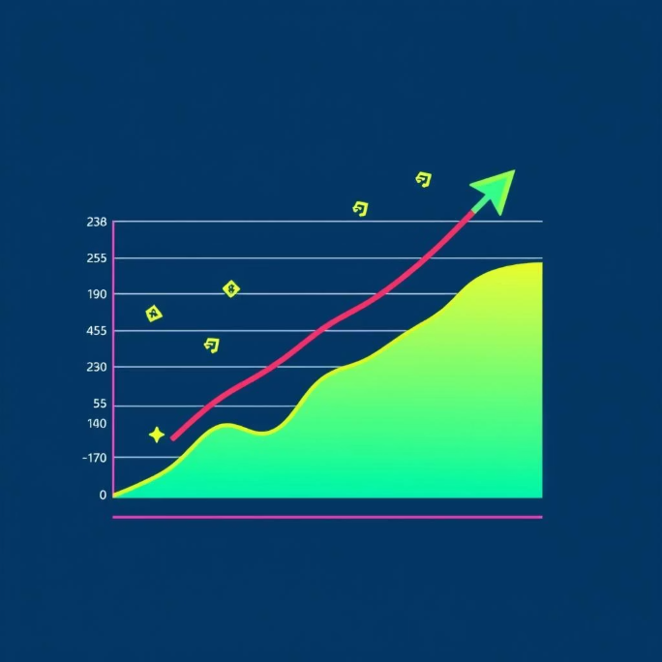

Step 4: AI Models - Regression & Clustering
Regression Models
Clustering Models
Predicting continuous numerical values for enhanced planning.
Unsupervised grouping of customers for targeted strategies.
Purpose: Forecasts next service cost, days until next service, and Customer Lifetime Value (CLTV).
Purpose: Segments customers based on driving behavior, service spend, feedback sentiment, and service regularity.
Business Value: Supports predictive maintenance, accurate financial forecasting, and strategic warranty/AMC planning.
Business Value: Essential for customer profiling, product bundling, targeted offers, and capacity planning (e.g., "price-sensitive & regular" vs. "premium, late responders").

Slide 7
Step 5: Final Model & Output Generation
Preparing the trained models for operational use and generating actionable outputs.
Personalized Communication
Customer Segmentation Output
Trained Model Storage
Generates tailored reminder messages and recommends communication channels (email, WhatsApp, SMS, phone) in a CSV format for deployment.
Highly accurate model pipelines saved as .pkl or .joblib files (e.g., service_reminder_model.pkl).
Customers categorized into segments: Critical, High Priority, Medium, Low, based on prediction, due date, and feedback score.

Slide 8
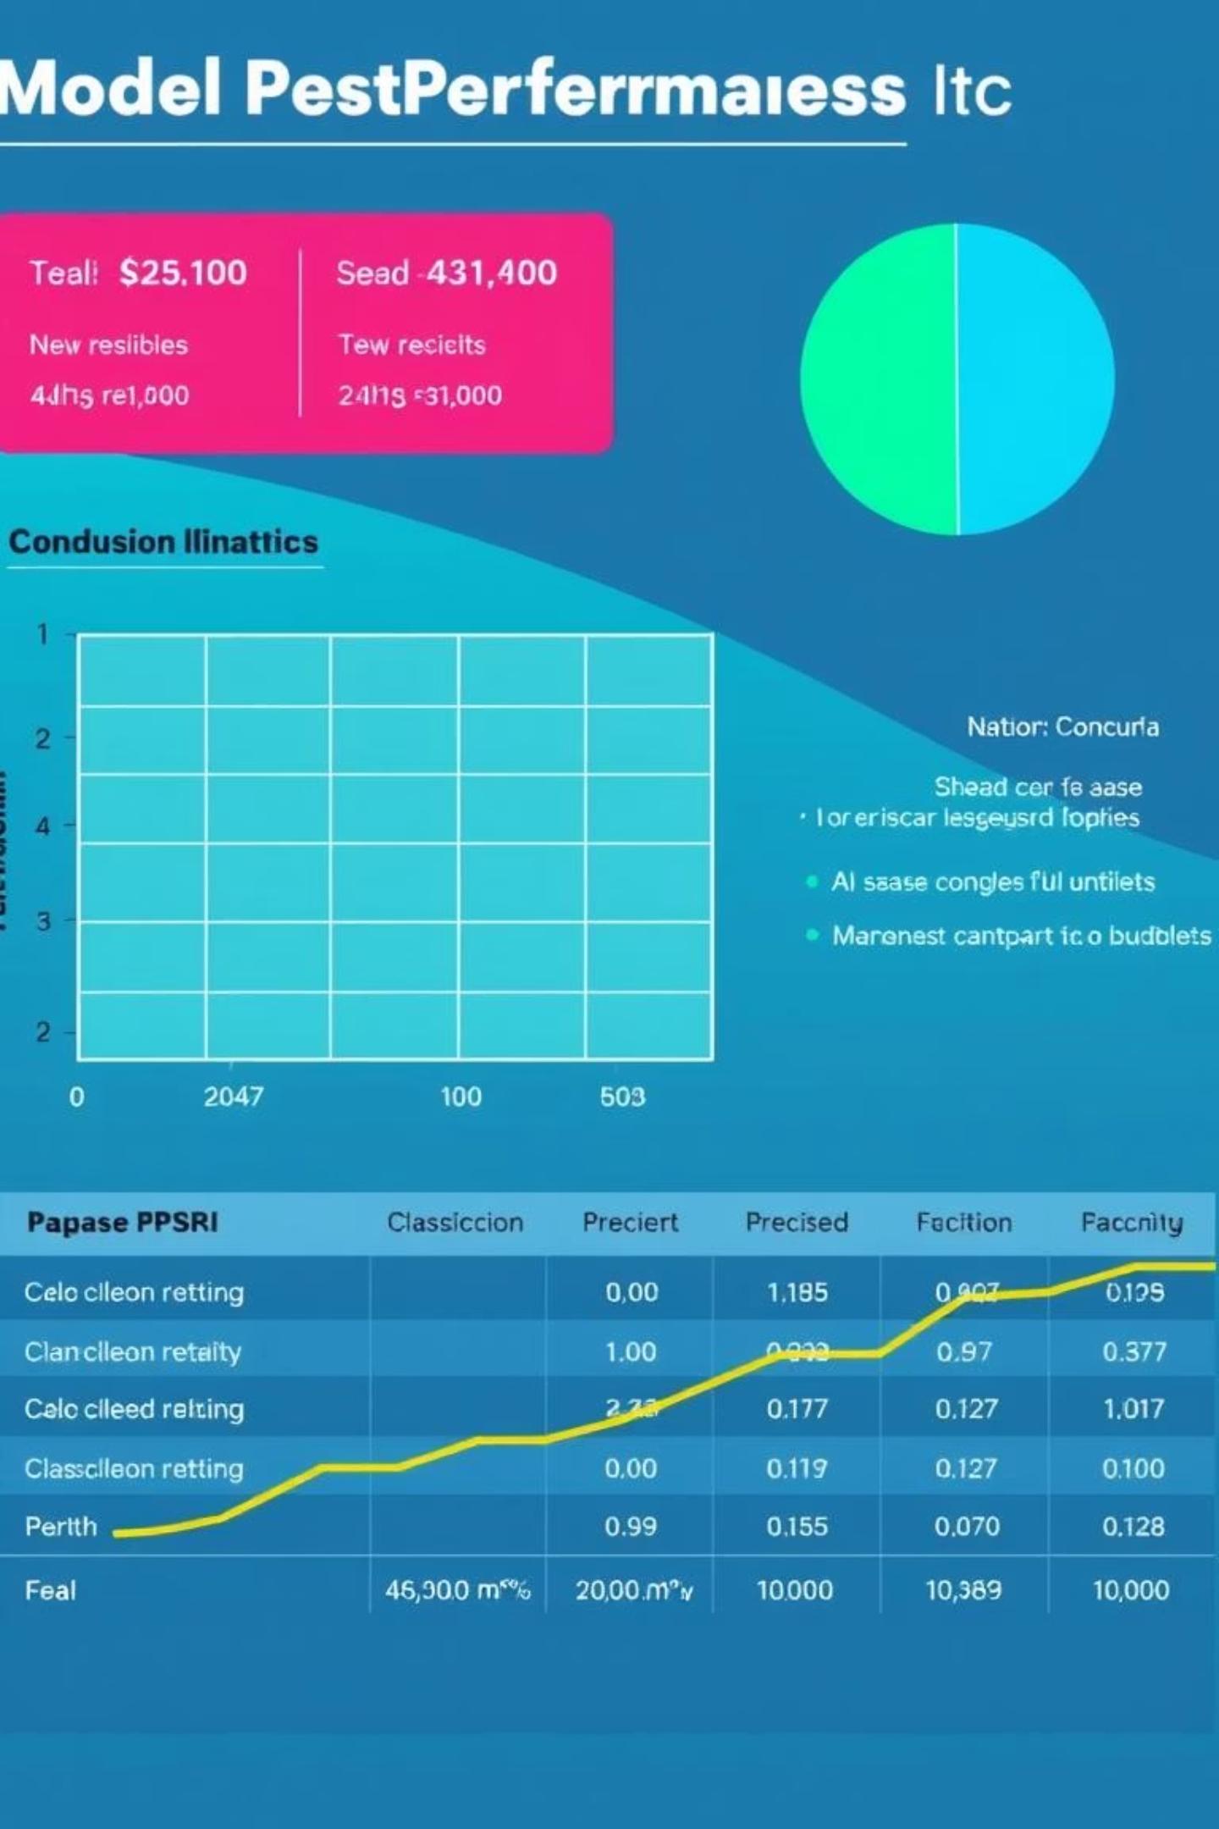
Step 6: Final Presentation & Performance Metrics
Showcasing the project's success through key results, workflow diagrams, and robust performance metrics.
Key Performance Indicators
Model Performance: Detailed classification reports and confusion matrices.
Accuracy: Classification models demonstrate near-perfect precision and recall (1.00) for urgent and high-priority customer identification.
Business ROI: Quantifying the return on investment from implementing the AI-driven system.

Slide 9



Deployment: From Data to Automated Action
Seamless integration into existing systems for continuous, automated service reminder generation.
Local/Server Batch Deployment
Model Deployment as a Service
CRM/Messaging Gateway Integration
Run Python script (e.g., 02.Classification_04.ipynb) with latest customer data (modify_service_df.csv) to generate ai_based_service_reminder.csv.
Export trained model (service_reminder_model.pkl) as a Flask/FastAPI microservice or scheduled script.
Connect deployed service with CRM systems or messaging gateways for automated dispatch of communications.

Slide 10
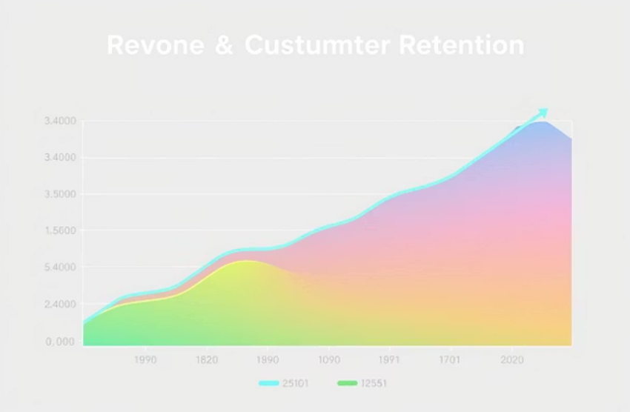



Transforming Automotive After-Sales: Our Impact
This AI-driven system creates significant value by optimizing operations and enhancing customer relationships.
Increased Revenue: Through enhanced customer retention and strategic upselling.
Reduced Operational Costs: By automating routine service reminder tasks.
Hyper-Personalization: Fostering improved customer loyalty and satisfaction.
Enhanced Customer Experience: Making the after-sales journey smart, automated, and customer-centric.

